Slide 1

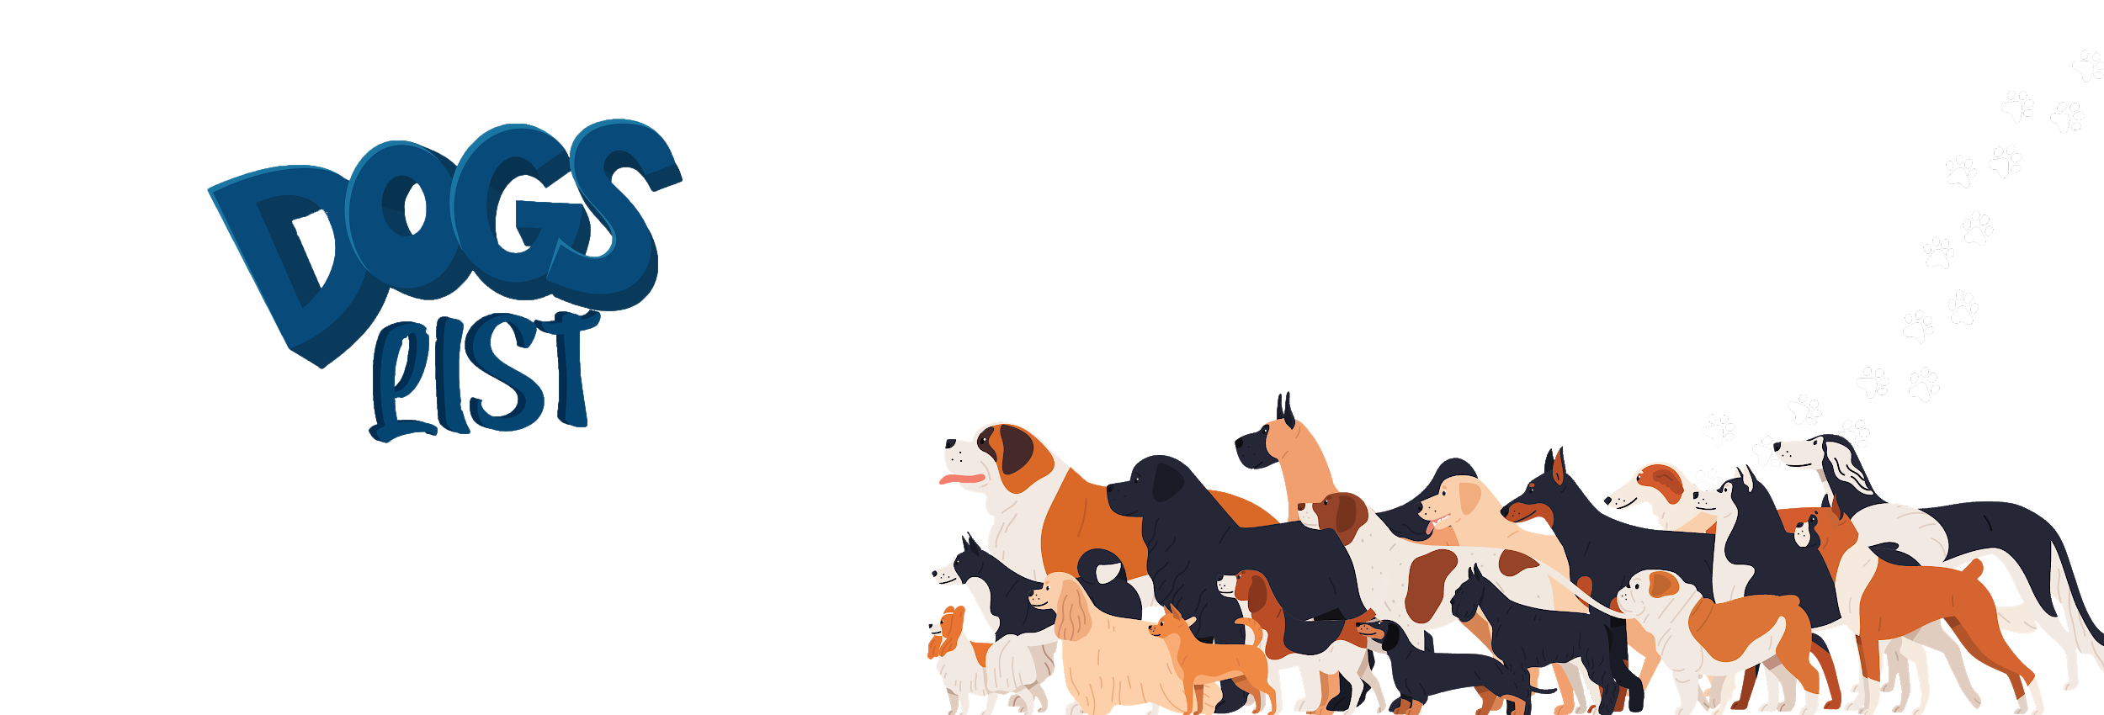


Slide 2
What Is Dogslist?
Dogslist is Craigslist for dogs.
Have a dog? Post a dog. Need a dog? Adopt a dog.

Slide 3

Background
It’s 2020. Parents are “working” from home. Kids are bouncing off the walls. Couples are squabbling. Single people have gained their COVID-19—and then some. What to do?

Slide 4
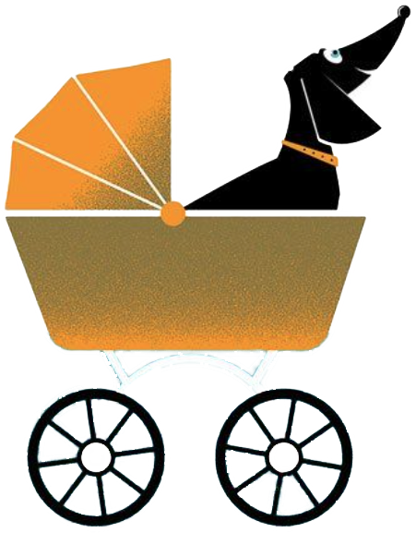
Hey, let’s get a dog!

Slide 5

The Problem
It’s 2021. That adorable pandemic puppy now weighs 60 lb. and has a scent only a mother could love. Folks are returning to work, leaving the dog cooped up all day. And let’s face it—no one wants to pick up poop.

Slide 6
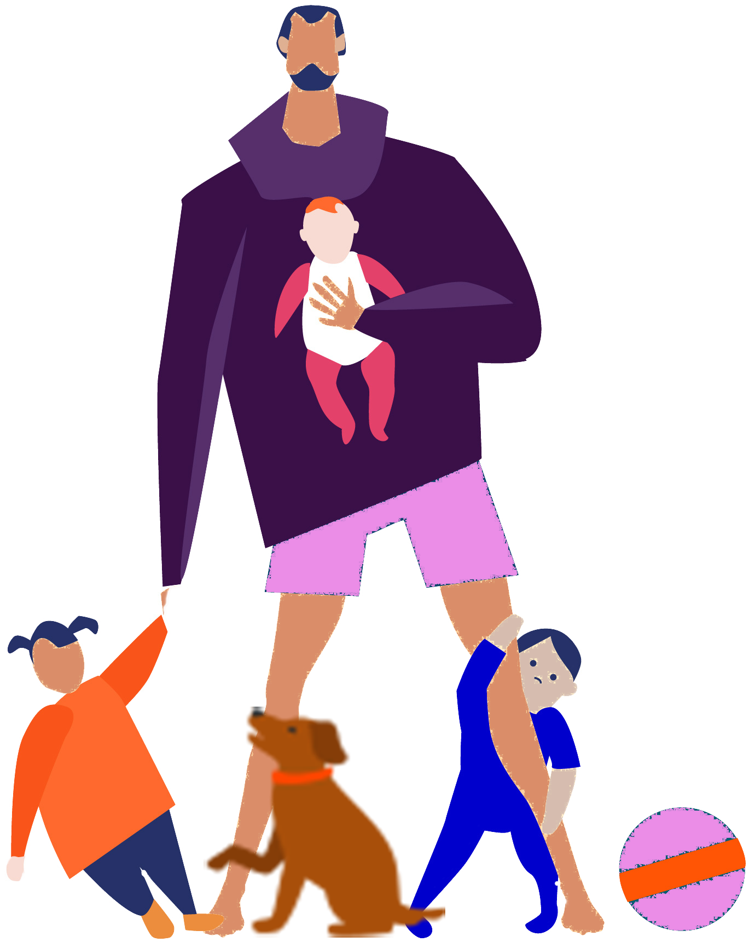
The Solution
Dogslist lets New Yorkers bypass the shelter and deal directly with another family to rehome or adopt a pet.

Slide 7
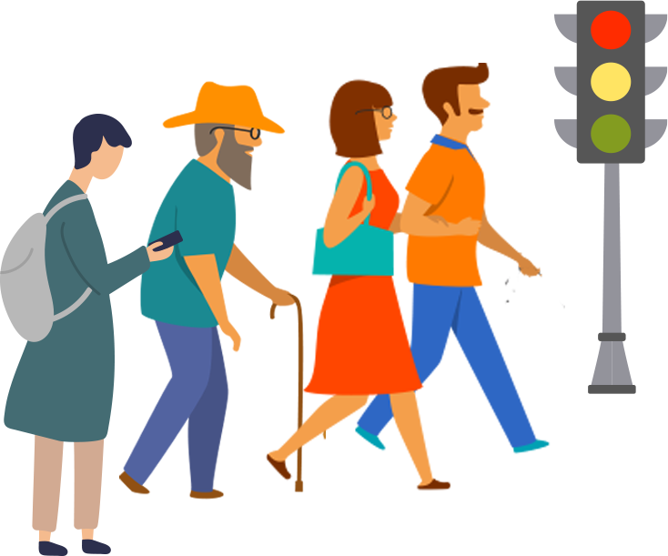
How It Works
Neighbors who need to rehome a dog can post an ad, and
those looking for a dog can browse posts and contact the current pet owner to arrange for pickup.

Slide 8
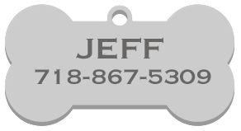
Typical User Story (Seeker)
AS A pale, anemic, bored, lonely, and slightly doughy New Yorker
I WANT A fluffy companion (the cuter, the better)
SO I won’t have to stay holed up like a rat in my dank, depressing apartment
BECAUSE doggoneit, people like me!

Slide 9
Typical User Story (Rehomer)
AS A stressed out, impatient, hard-hearted New York City a-hole
I WANT to get rid of this f*ing dog, already
SO I won’t have to buy dog food (have you seen how much that sh*t costs?), go for f*ing walks (who does that?), and pick up its f*ing poop
BECAUSE I’m so over the whole pet thing

Slide 10
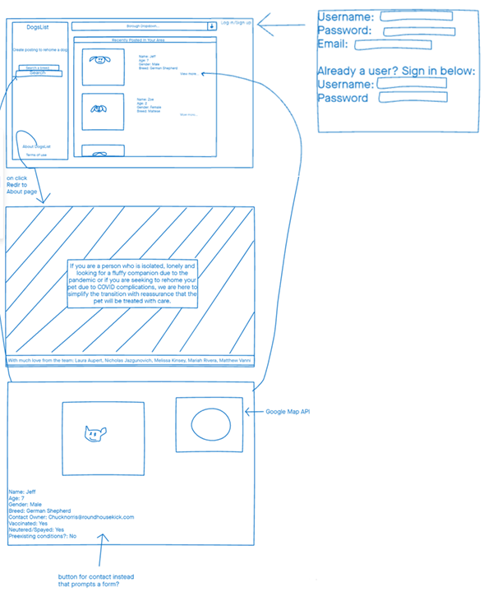
Development
We used wireframes to plan the app’s functionality and its look and feel

Slide 11
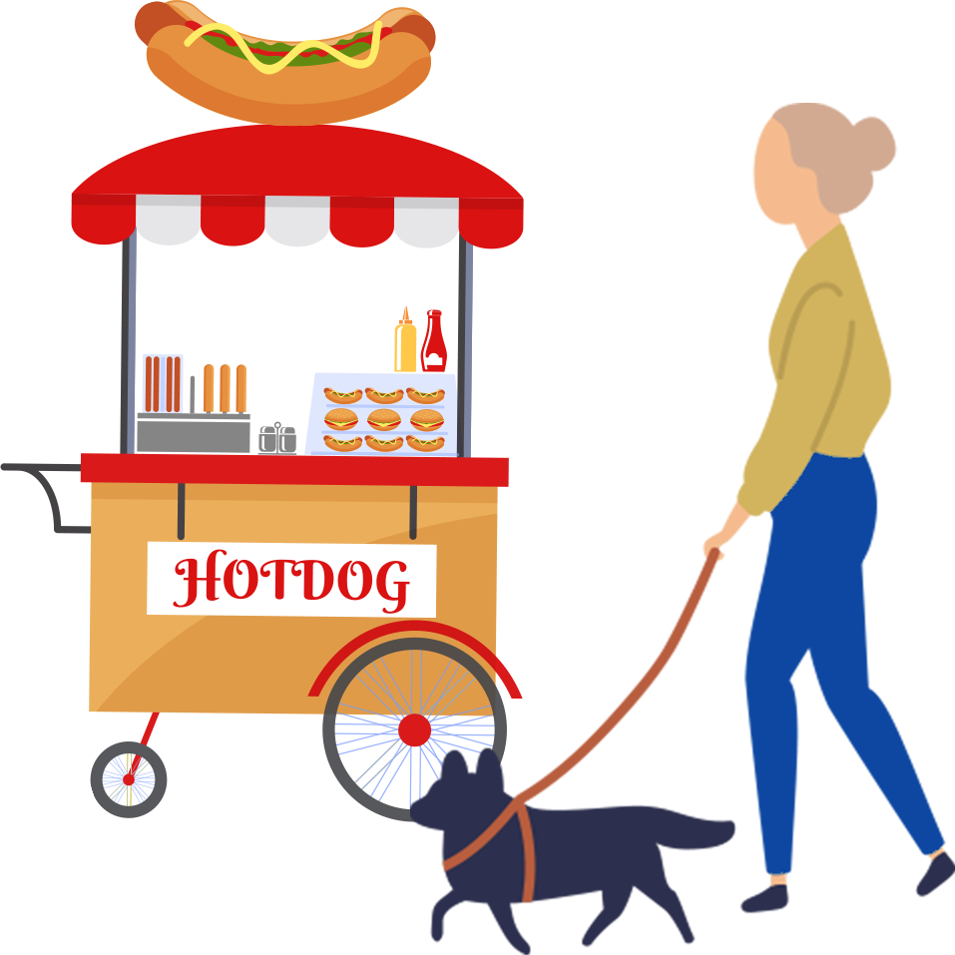
Technologies Used
SQL, Sequelize, HTML/CSS, Javascript, Bootstrap, Node, Heroku, Google Maps API, Handlebars, CSS templates
AWS S3 cloud storage
Tears, f-bombs, and smoke signals spelling out the word L-A-U-R-A

Slide 12
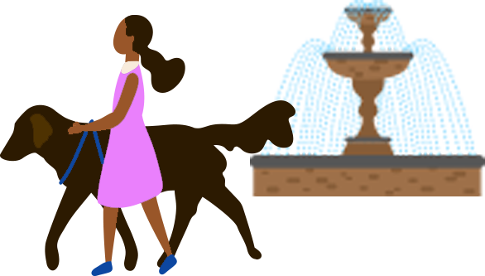
Responsibilities
Laura—Backend everything, TA, and first responder
Mariah—Maps API, Sequelize models, landing page image
Matt—UI design using Handlebars, Bootstrap, HTML/CSS, debugger
Nick—AWS S3 storage for seed files
Melissa—Concept, presentation, README

Slide 13
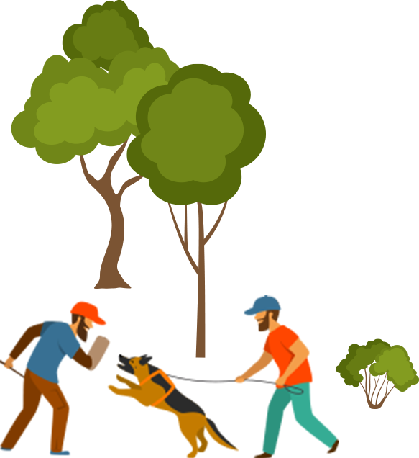
Challenges
Frontend and backend came together separately (can’t route to a button that’s not there yet, for example)
Communication—sometimes there were too many cooks in the kitchen
Git conflicts and confusion
Too many technologies in the kitchen

Slide 14

Successes
It works!
Learned how the frontend and backend work together in the model-view-controller (MVC) model
Learned to set up AWS S3 storage, use Handlebars templates, use Google Maps API, and deploy on Heroku.

Slide 15
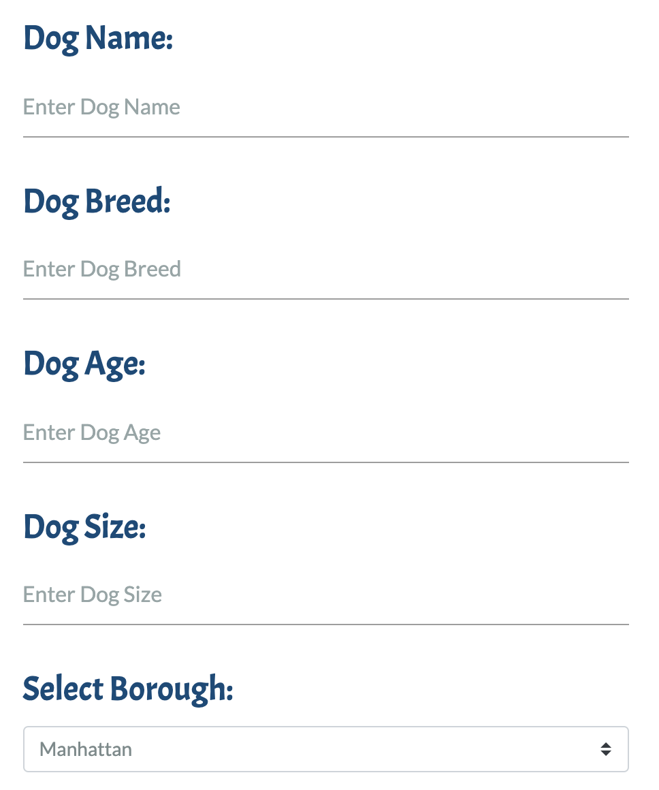

Directions for Future Development
We plan to add a filtering function so that people looking for dogs can filter by location, breed, size, age, and other criteria.
We’ll load additional criteria, such as whether the dog is spayed/neutered and what its preferred pronouns are.

Slide 16
Links
github.com/lauraaupert/DogsList

